Slide 1
CHAPTER 1
Strategic Management and Strategic Competitiveness

Slide 2

KNOWLEDGE OBJECTIVES
Studying this chapter should provide you with the strategic management knowledge needed to:
Define strategic competitiveness, strategy, competitive advantage, above-average returns, and the strategic management process.
Describe the 21st-century competitive landscape and explain how globalization and technological changes shape it.
Use the industrial organization (I/O) model to explain how firms can earn above-average returns.
Use the resource-based model to explain how firms can earn above-average returns.
1–<number>

Slide 3
KNOWLEDGE OBJECTIVES (cont’d)
Studying this chapter should provide you with the strategic management knowledge needed to:
Describe vision and mission and discuss their value.
Define stakeholders and describe their ability to influence organizations.
Describe the work of strategic leaders.
Explain the strategic management process.
1–<number>

Slide 4
Important Definitions
Strategic Competitiveness
  When a firm successfully formulates and implements a value-creating strategy.
Strategy
  An integrated and coordinated set of commitments and actions designed to exploit core competencies and gain a competitive advantage.
Competitive Advantage
  When a firm implements a strategy that its competitors are unable to duplicate or find too costly to try to imitate.
1–<number>

Slide 5
Important Definitions (cont’d)
Risk
  An investor’s uncertainty about the economic gains or losses that will result from a particular investment.
Average Returns
  Returns equal to those an investor expects to earn from other investments with a similar amount of risk.
Above-average Returns
  Returns in excess of what an investor expects to earn from other investments with a similar amount of risk.
1–<number>

Slide 6

Important Definitions (cont’d)
Strategic Management Process
  The full set of commitments, decisions, and actions required for a firm to achieve strategic competitiveness and earn above-average returns.
1–<number>

Slide 7
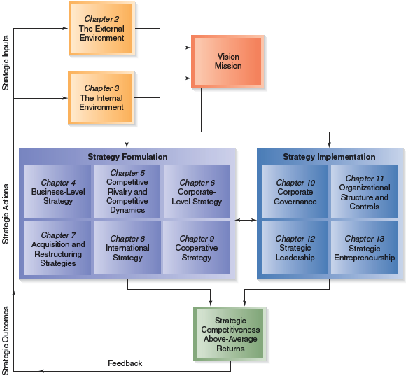

FIGURE 1.1
The Strategic Management Process
1–<number>

Slide 8
The 21st-Century Competitive Landscape
A Perilous Business World
  Rapid changes in industry boundaries and markets
  Conventional sources of competitive advantage losing effectiveness
  Enormous investments required to compete globally
  Severe consequences for failure
Developing and Implementing Strategy
  Allows for planned actions rather than reactions
  Helps coordinate business unit strategies
1–<number>

Slide 9

The Competitive Landscape
Hypercompetition
A condition of rapidly escalating competition based on:
Price-quality positioning
Competition to create new know-how and establish first-mover advantage
Competition to protect or invade established product or geographic markets
Dynamic
Global Economy
Rapid technological
change
Strategic maneuvering
among global and innovative
combatants
1–<number>

Slide 10
I/O Model of Above-Average Returns
Dominance of the External Environment
  The industry in which a firm competes has a stronger influence on the firm’s performance than do the choices managers make inside their organizations.
Industry Properties Determining Performance
  Economies of scale
  Barriers to market entry
  Diversification
  Product differentiation
  Degree of concentration of firms in the industry
1–<number>

Slide 11
Four Assumptions of the I/O Model
1
External environment imposes pressures and constraints that determine strategies leading to above-average returns.
2
Most firms competing in an industry control similar strategically relevant resources and pursue similar strategies.
3
Resources used to implement strategies are highly mobile across firms.
Organizational decision makers are assumed to be rational and committed to acting in the firm’s best interests (profit-maximizing).
4
1–<number>

Slide 12
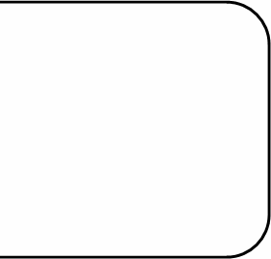
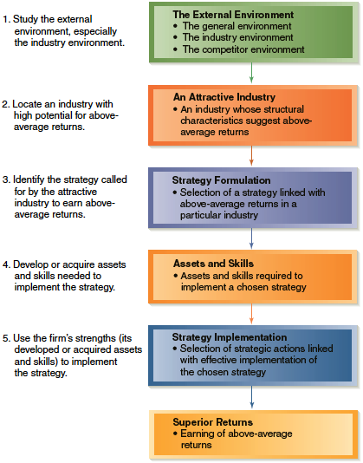
FIGURE 1.2
The I/O Model of Above-Average Returns
1–<number>

Slide 13

Industrial Organization (I/O) Model
The External Environment
Attractive Industry
Strategy Formulation
Assets and Skills
Strategy Implementation
Superior Returns
Superior returns: earning above-average returns
1–<number>

Slide 14
Strategies:
Firms earn above-average returns by:
  Cost leadership
    Producing standardized products or services
  Differentiation
    Manufacturing differentiated products for which customers are willing to pay a price premium
  -Niche: Specialized products to fulfill a specific market.
1–<number>

Slide 15
Five Forces Model of Competition
Industry Profitability
  The industry’s rate of return on invested capital relative to its cost of capital
An industry’s profitability results from interaction among:
  Suppliers
  Buyers
  Competitive rivalry among firms currently in the industry
  Product substitutes
  Potential entrants to the industry
1–<number>

Slide 16
The Resource-Based Model of Above-Average Returns
Model Assumptions
  Each organization is a collection of unique resources and capabilities that provides the basis for its strategy and that is the primary source of its returns.
  Capabilities evolve and must be managed dynamically.
  Differences in firms’ performances are due primarily to their unique resources and capabilities rather than structural characteristics of the industry.
  Firms acquire different resources and develop unique capabilities.
1–<number>

Slide 17
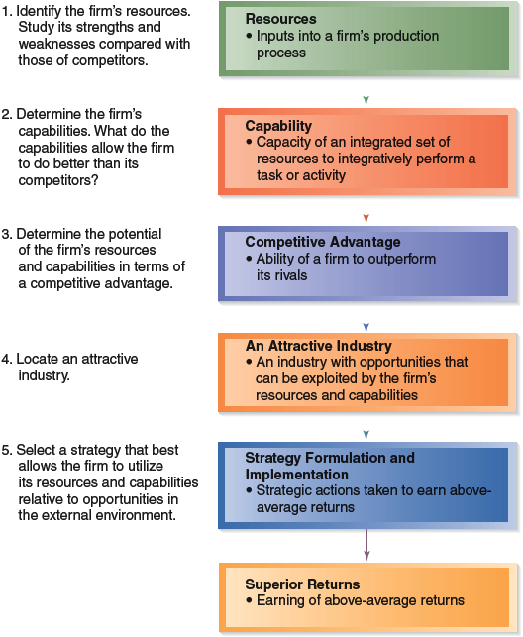
FIGURE 1.3
The Resource-Based Model of Above-Average Returns
1–<number>

Slide 18
Resource-Based Model of Above-Average Returns (cont’d)
1. Strategy is dictated by the firm’s unique resources and capabilities.
2. Find an environment in which to exploit these assets (where are the best opportunities?)
Strategy:
Competitive Advantage
Resources
Capabilities
Core Competencies
Environment
1–<number>

Slide 19
Resource-Based Model (cont’d)
Resources
Capability
Competitive Advantage
Attractive Industry
Strategy Formulation
and Implementation
Superior Returns
Superior returns: earning above-average returns
1–<number>

Slide 20
Why Two Models?
Industrial Organization (I/O) Model
  Focuses on the environment outside the firm.
Resource-Based Model
  Focuses on the inside of the firm
Successful strategy formulation and implementation actions result only when the firm properly uses both models.
1–<number>

Slide 21
Stakeholders
Individuals and groups who can affect, and are affected by, the strategic outcomes achieved and who have enforceable claims on a firm’s performance.
  Claims on the firm’s performance are enforced by the stakeholder’s ability to withhold participation essential to the firm’s survival.
  The more critical and valued a stakeholder’s participation, the greater a firm’s dependency on it.
  Managers must find ways to either accommodate or insulate the organization from the demands of stakeholders controlling critical resources.
1–<number>

Slide 22

Stakeholder Involvement
Two issues affect the extent of stakeholder involvement in the firm:
  How to divide returns
  to keep stakeholders
  involved?
  How to increase
  returns so everyone
  has more to share?
1–<number>

Slide 23
Organizational Stakeholders
Employees
  Expect a dynamic, stimulating and rewarding work environment.
  Are satisfied by a company that is growing and actively developing their skills.
1–<number>

Slide 24

Strategic Leaders
Strategic Leaders
  People located in different parts of the firm who are using the strategic management process to help the firm reach its vision and mission.
Prerequisites for Effective Strategic Leadership
  Hard work
  Thorough analyses
  Honesty
  Desire for accomplishment
  Common sense
1–<number>

Slide 25
Strategic Leaders (cont’d)
Organizational Culture
  The complex set of ideologies, symbols, and core values that are shared throughout the firm and that influence how the firm conducts business.
The Value of a Functional Organizational Culture
  Supports effective delegation of strategic responsibilities
  Provides support for strategic leaders
  Encourages social energy
  Fosters of respect for others
1–<number>

Slide 26
Strategic Management Process
Study the external and internal environments.
Identify marketplace opportunities and threats.
Determine how to use core competencies.
Use strategic intent to leverage resources, capabilities and core competencies and win competitive battles.
Integrate formulation and implementation of strategies.
Seek feedback to improve strategies.
1–<number>

